Slide 1
Planning action sequence with Offline RL
Fast and smooth pre-heat phase in ovens

Slide 2
NO transition dynamics model is needed:

Slide 3
Method I – Open-loop dynamical systems planning control with IRL from batch data
Batch Dataset
Generator
T_demo:
{S_demo, A_demo}
Policy REINFORCE LSTM NN:
S0 -> {a1,a2,a3..} ∊ A_samp
Discriminator
SysModel Seq2seq:
A_samp -> S_samp
Cost FeedForw NN:
T_samp
+ -> R
Tdemo
T_samp:
{S_samp, A_samp}
Unroll policy

Slide 4
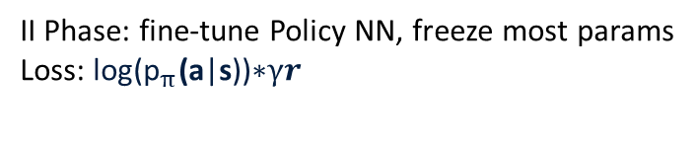
Method II – Open-loop dynamical systems planning control pre-trained from batch data
Policy NN LSTM:
S0 -> {a1,a2,a3..} ∊ A_samp
Use rewards to loss
Batch Dataset
T_demo:
{S_demo[0], A_demo}
SysModel Seq2seq LSTM:
A_samp -> S_samp
Extract hand-crafted rewards
Unroll policy
I Phase: pre-train Policy NN with batch data (one-to-many)
Loss: cross-entropy
II Phase: fine-tune Policy NN, freeze most params
Loss: $\text{log}\text{(}{\text{p}}_{π}\text{(}\text{a}\text{|}\text{s}\text{))∗}γr$

Slide 5
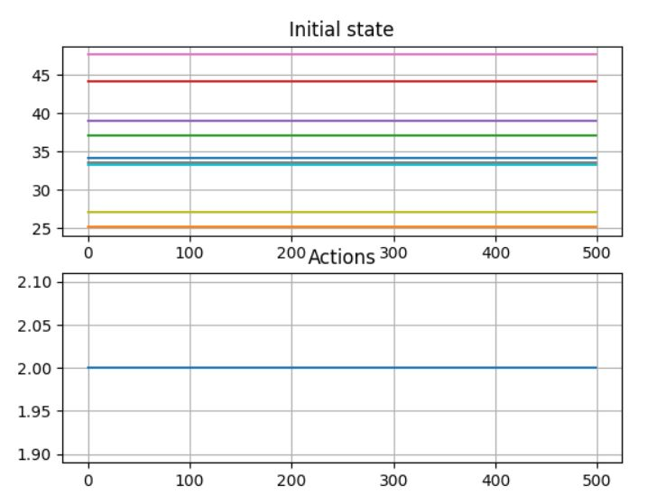
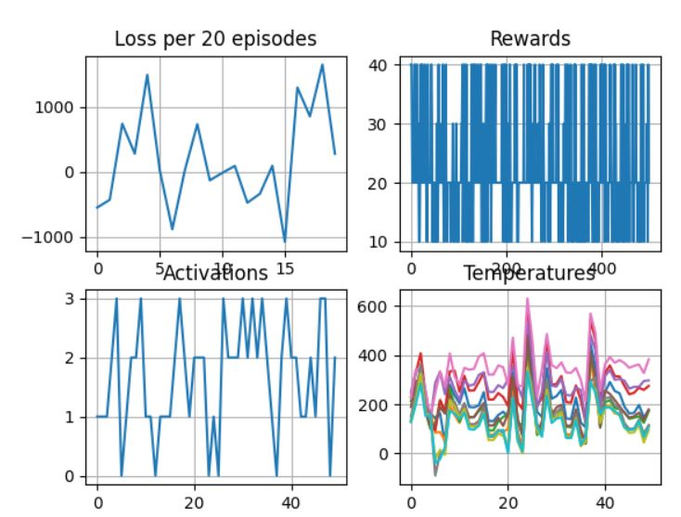
Method II – «Results»
I Phase
(train with batch data S0->Action Sequence)
II Phase
(fine-tune with REINFORCE)
TODO: try actor-critic and frame skip steps
https://rohan-v-thorat.github.io/pages/blogs/Deriving-Actor-Critic-method-along-with-some-intuition.html in progress
https://discuss.pytorch.org/t/is-there-a-way-to-combine-classification-and-regression-in-single-model/165549/2 done

Slide 6
Methods where the transition dynamics model is needed for evaluation:
Decision Transformer – implemented LSTM
Stitching BC
Off-policy - ConservativeQL

Slide 7
Decision Transformer
In training:
Input States, Action, Cumulative Rewards trajectories in [t]
Output Actions in [t+1]
Loss MSE
In test:
Input S0 (initial state), Total expected reward (can be higher than in batch)
Output: At each inference, for an estimated action, perform env.step()
TODO: evaluate on oven

Slide 8
Transition dynamics model
LSTM + Results
Padded CNN + LSTM – TODO
Update : NO NEED for padding
Option: directly on OVEN with Rapid Control Prototype

Slide 9
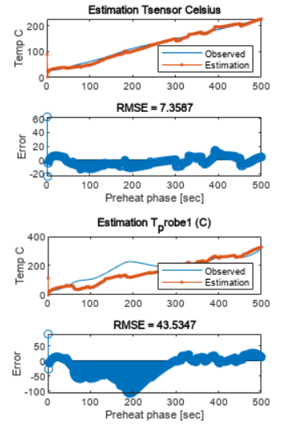
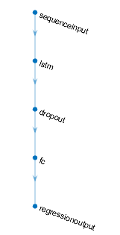
LSTM – «Results»
TODO try training on first 500 steps
UPDATE DONE – works also for less steps, 5, 10 etc.

Slide 10
Sequence dynamics model:
CNN + LSTM - Results

Slide 11
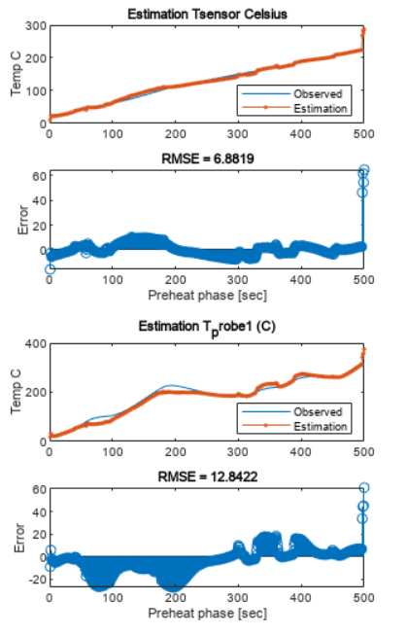
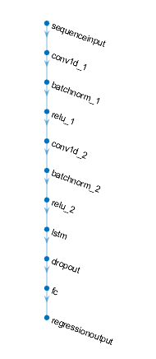
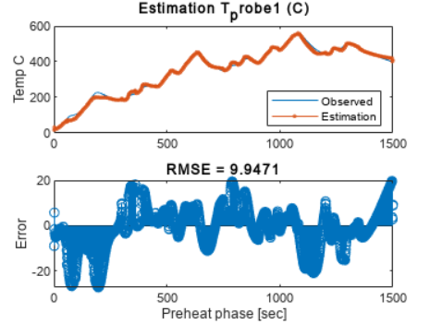
CNN + LSTM
* The model is trained on 1500 steps

Slide 12
MoM meeting Celani
2310.05808.pdf (arxiv.org)
Limits policy
Open-loop
Optimization problem, not RL
I can do non-RL and prove that its better than the RL I have tried

Slide 13
Update 17/12/2023
Do meeting with prof Celani in person
DO Predictive LSTM – input set of state output action+duration for the next set of states
DO regular RL, do state by state and show physically how the system would react for opening door, putting food etc.

